Slide 1
4-7: Final helpful hints for tests
By Barbara Oakley, PhD

Slide 2
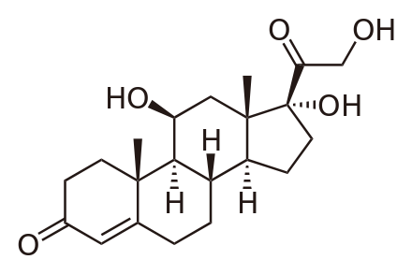
Chemical structure of cortisol
How you interpret!
This test has made me afraid
This test has made me excited to do my best!

Slide 3
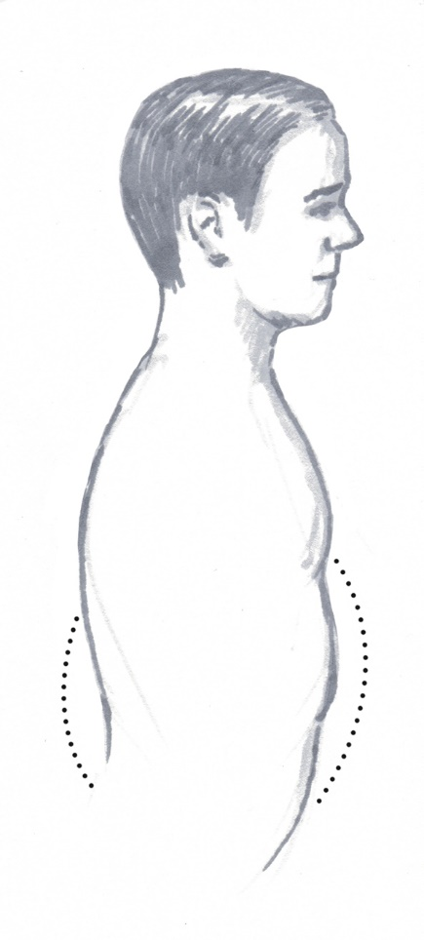
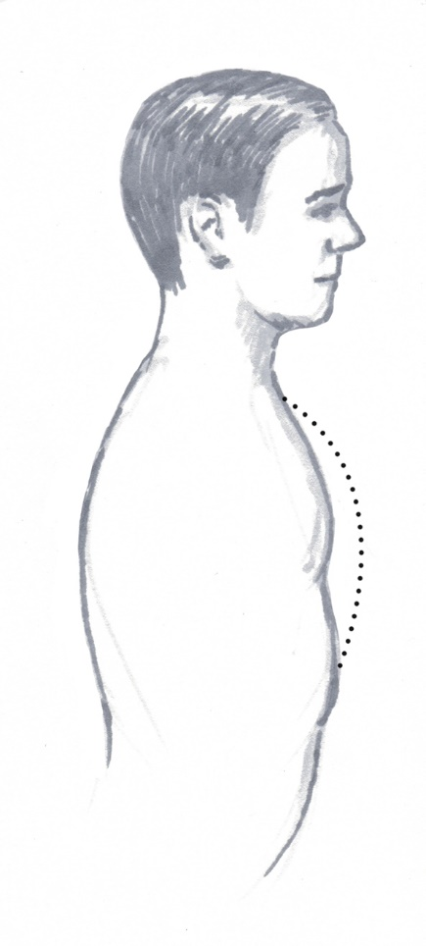


Slide 4
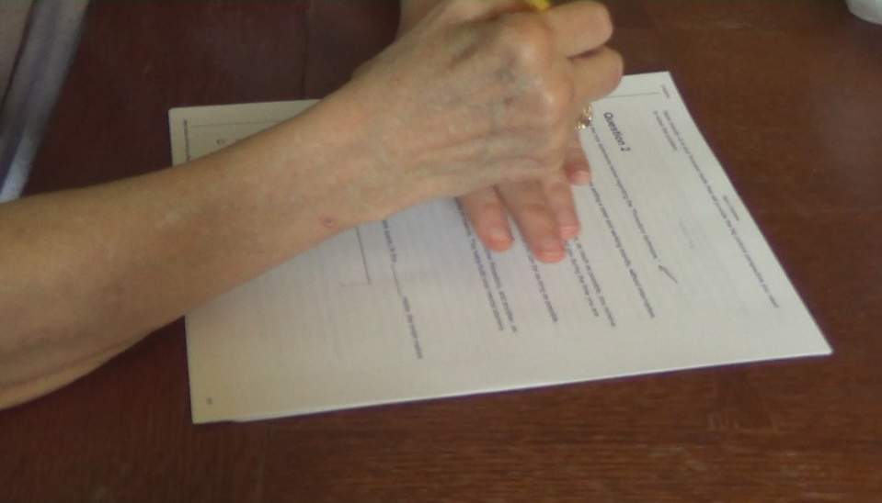

Slide 5
Face your fears
“Good worry”
Have a “Plan B”!
“Bad worry”

Slide 6
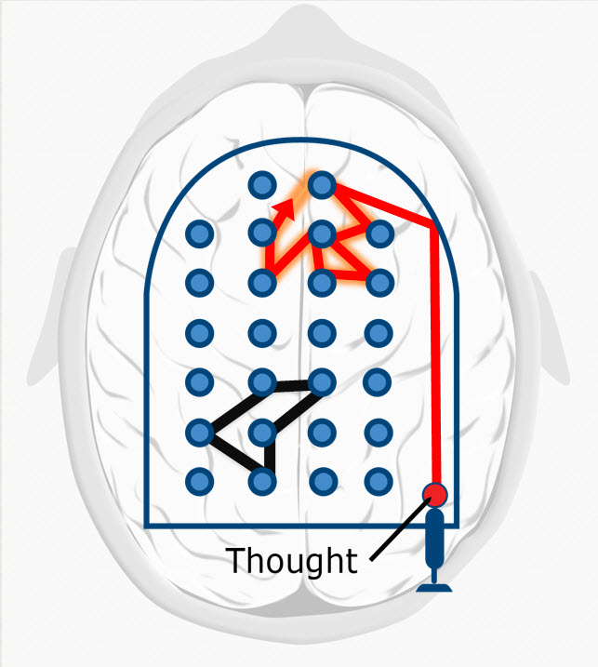
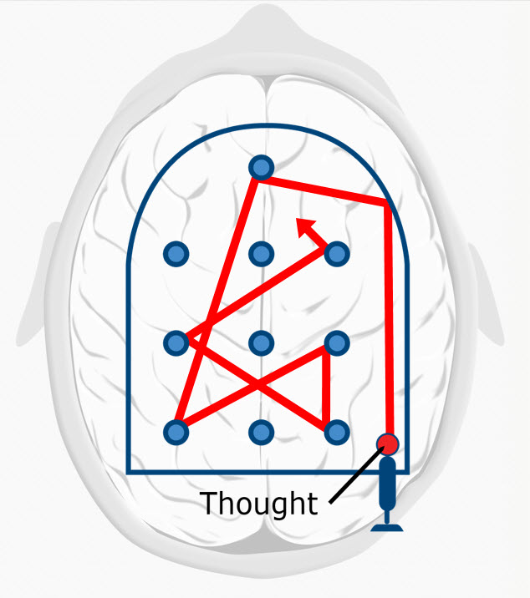

Slide 8
Illustration credits
Chemical structure of cortisol, by Calvero, http://en.wikipedia.org/wiki/Cortisol#mediaviewer/File:Cortisol2.svg
Breathing, ©Rachel Oakley, 2014.
Hands courtesy Barb Oakley
Various neural pinball images ©Kevin Mendez, 2014.
Clip art courtesy Microsoft Corporation
Relevant Readings
Beilock, S. (2010). Choke. NY: Free Press.
Jerath, R., Edry, J. W., Barnes, V. A., & Jerath, V. (2006). Physiology of long pranayamic breathing: neural respiratory elements may provide a mechanism that explains how slow deep breathing shifts the autonomic nervous system. Medical Hypotheses, 67(3), 566-571.
Nakano, T., Kato, M., Morito, Y., Itoi, S., & Kitazawa, S. (2012). Blink-related momentary activation of the default mode network while viewing videos. PNAS, 110(2), 702-706. doi: 10.1073/pnas.1214804110
Paul, G., Elam, B., & Verhulst, S. J. (2007). A longitudinal study of students' perceptions of using deep breathing meditation to reduce testing stresses. Teaching and Learning in Medicine, 19(3), 287-292.

